Slide 1
Style Transfer for Anime Sketches with Enhanced Residual U-net and Auxiliary Classifier GAN

Slide 2
Group Members:-
Ayesha Khatun Rima(011 163 117)
Farhana Meem (011 171 031 )
A.B.M. Naveed Hossain(011 163 125)
Noibedya Narayan Ray(011 163 101)

Slide 3
Introduction
Purpose
Applications

Slide 4
AC-GAN
U-Net

Slide 5
GAN

Slide 6
Generative Adversarial NetworkS
Created in 2014 by Ian Goodfellow
Semi-supervised learning
Used in Image / audio synthesis

Slide 7
Why is it Adversarial ?

Slide 8
2 components :
Generator : Replicate real data to produce fake data
Discriminator : Distinguishes real data from fake data

Slide 9
Steps to train a GAN :
Define the problem
Define GAN Architecture
Train Discriminator to distinguish “real” vs “fake” data
Train Generator synthesize data
Repeat steps 3 and 4 for N times

Slide 10
Loss Function
Discriminator is a binary classifier
Cross Entropy Loss :
H( p,q )= - p log(q) – ( 1-p ) log( 1-q )
Half sample from real dataset : x~p_data
Half sample from fake dataset : x~p_generator
D(x) : Predicted output of Discriminator
If D(x) = 0 , data is fake
Or if D(x) = 1 , data is real

Slide 11
Types of GAN :
Conditional GAN
Deep Convolutional GAN
Info GAN
Wasserstein GAN

Slide 12
CGAN

Slide 13
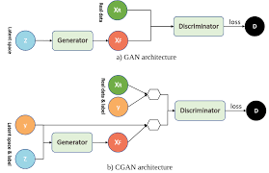
Conditional GAN
Input : Condition
Output : Specific types of output will be generated

Slide 14


Generate a random digit
Randomly
Sampled
Data
GAN
Generator
Randomly
Sampled
Data
CGAN
Generator
2

Slide 15
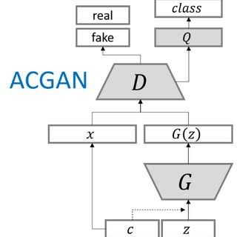
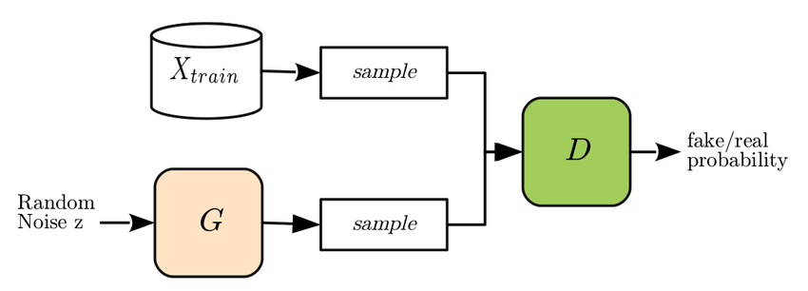

Slide 16
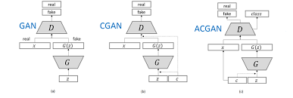

Slide 17
U-Net
Image Segmentation
CNN(Cumulative Neural Networking)
Very Lazy

Slide 18
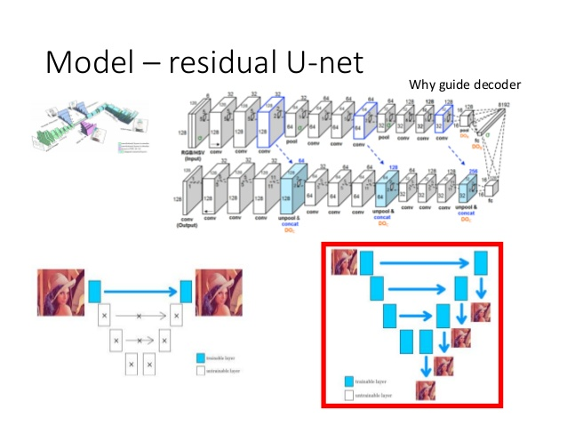

Slide 19
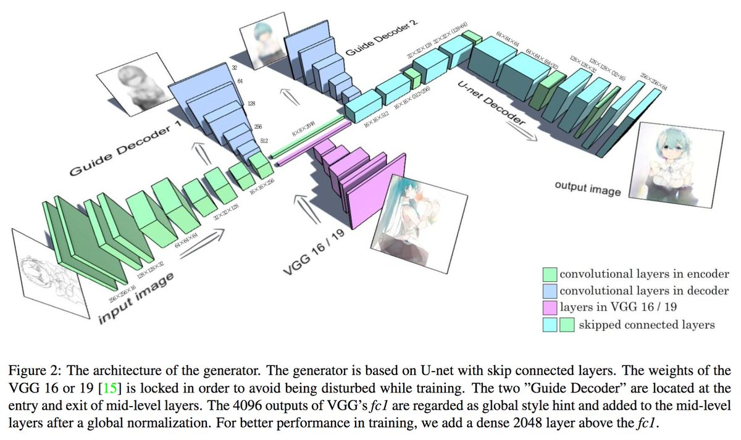

Slide 20
Methods
We combine an enhanced residual U-net generator and
an auxiliary classifier discriminator as our adversarial network.
We feed the generator with sketch maps and style
maps. Our discriminator can tell whether its input is real or
fake, and classify corresponding style simultaneously.

Slide 21
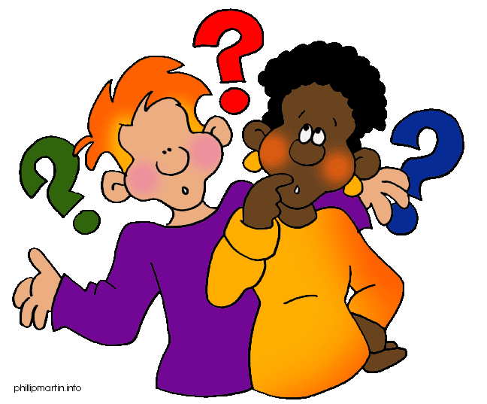

Slide 22
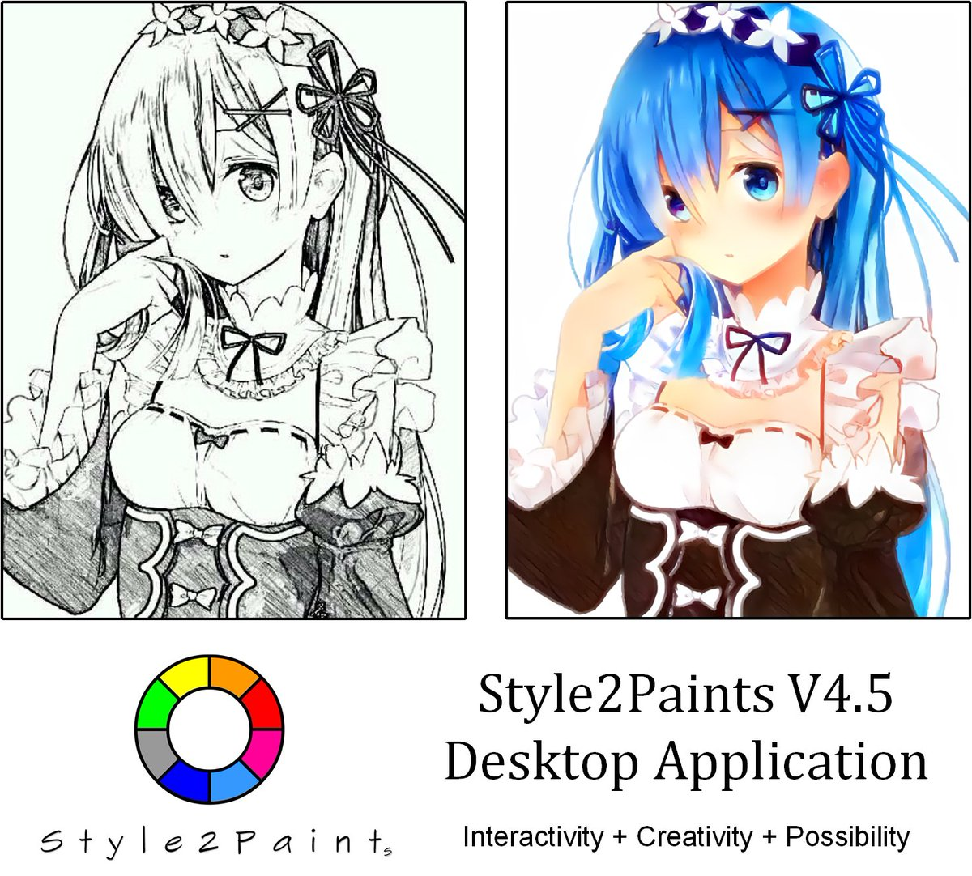

Slide 23
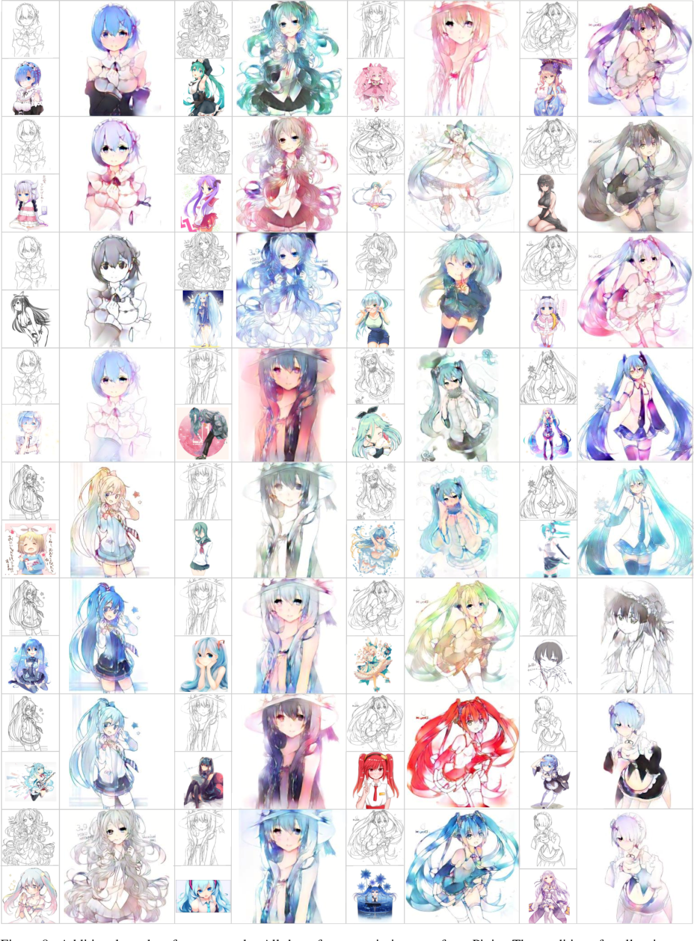

Slide 24
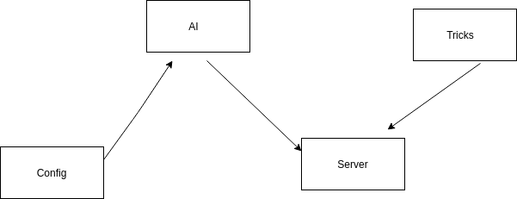

Slide 25
